Slide 1
Home Automation using Alexa Skill Kit and Aws
By: 20IT088 Disha Patel & 20IT075 Dhyani Panchal
Guided by : Prof. Sandip Patel

Slide 2
Introduction
In this modern era, automation of everything is the need of the modern and smart cities .Home Automation is used to control systems and information technology to regulate equipment, industrial machinery, and processes, minimizing the need for human involvement. Automation plays an increasingly important role in the global economy.
A Smart Home is one that provides comfort and security. And this is possible using home automation system.

Slide 3
What is Home Automation?
Home automation is the automatic control of electronic devices in your home. Home automation gives you access to control devices in your home from a mobile device anywhere in the world. These devices are connected to the internet, which allows them to be controlled remotely. Home automation makes life more convenient and can even save your money on heating, cooling and electricity bills. Home automation can also lead to a great safety with Internet of Things(IoT).
Understanding the term IoT:
The Internet of Things (IoT) refers to any device that is connected to the internet. For example, a smart AC that you can turn on and off using an app. All home automation devices are IoT devices which can be automated to trigger one another. Home automation is what you can do with the IoT devices to make your life a bit easier.

Slide 4
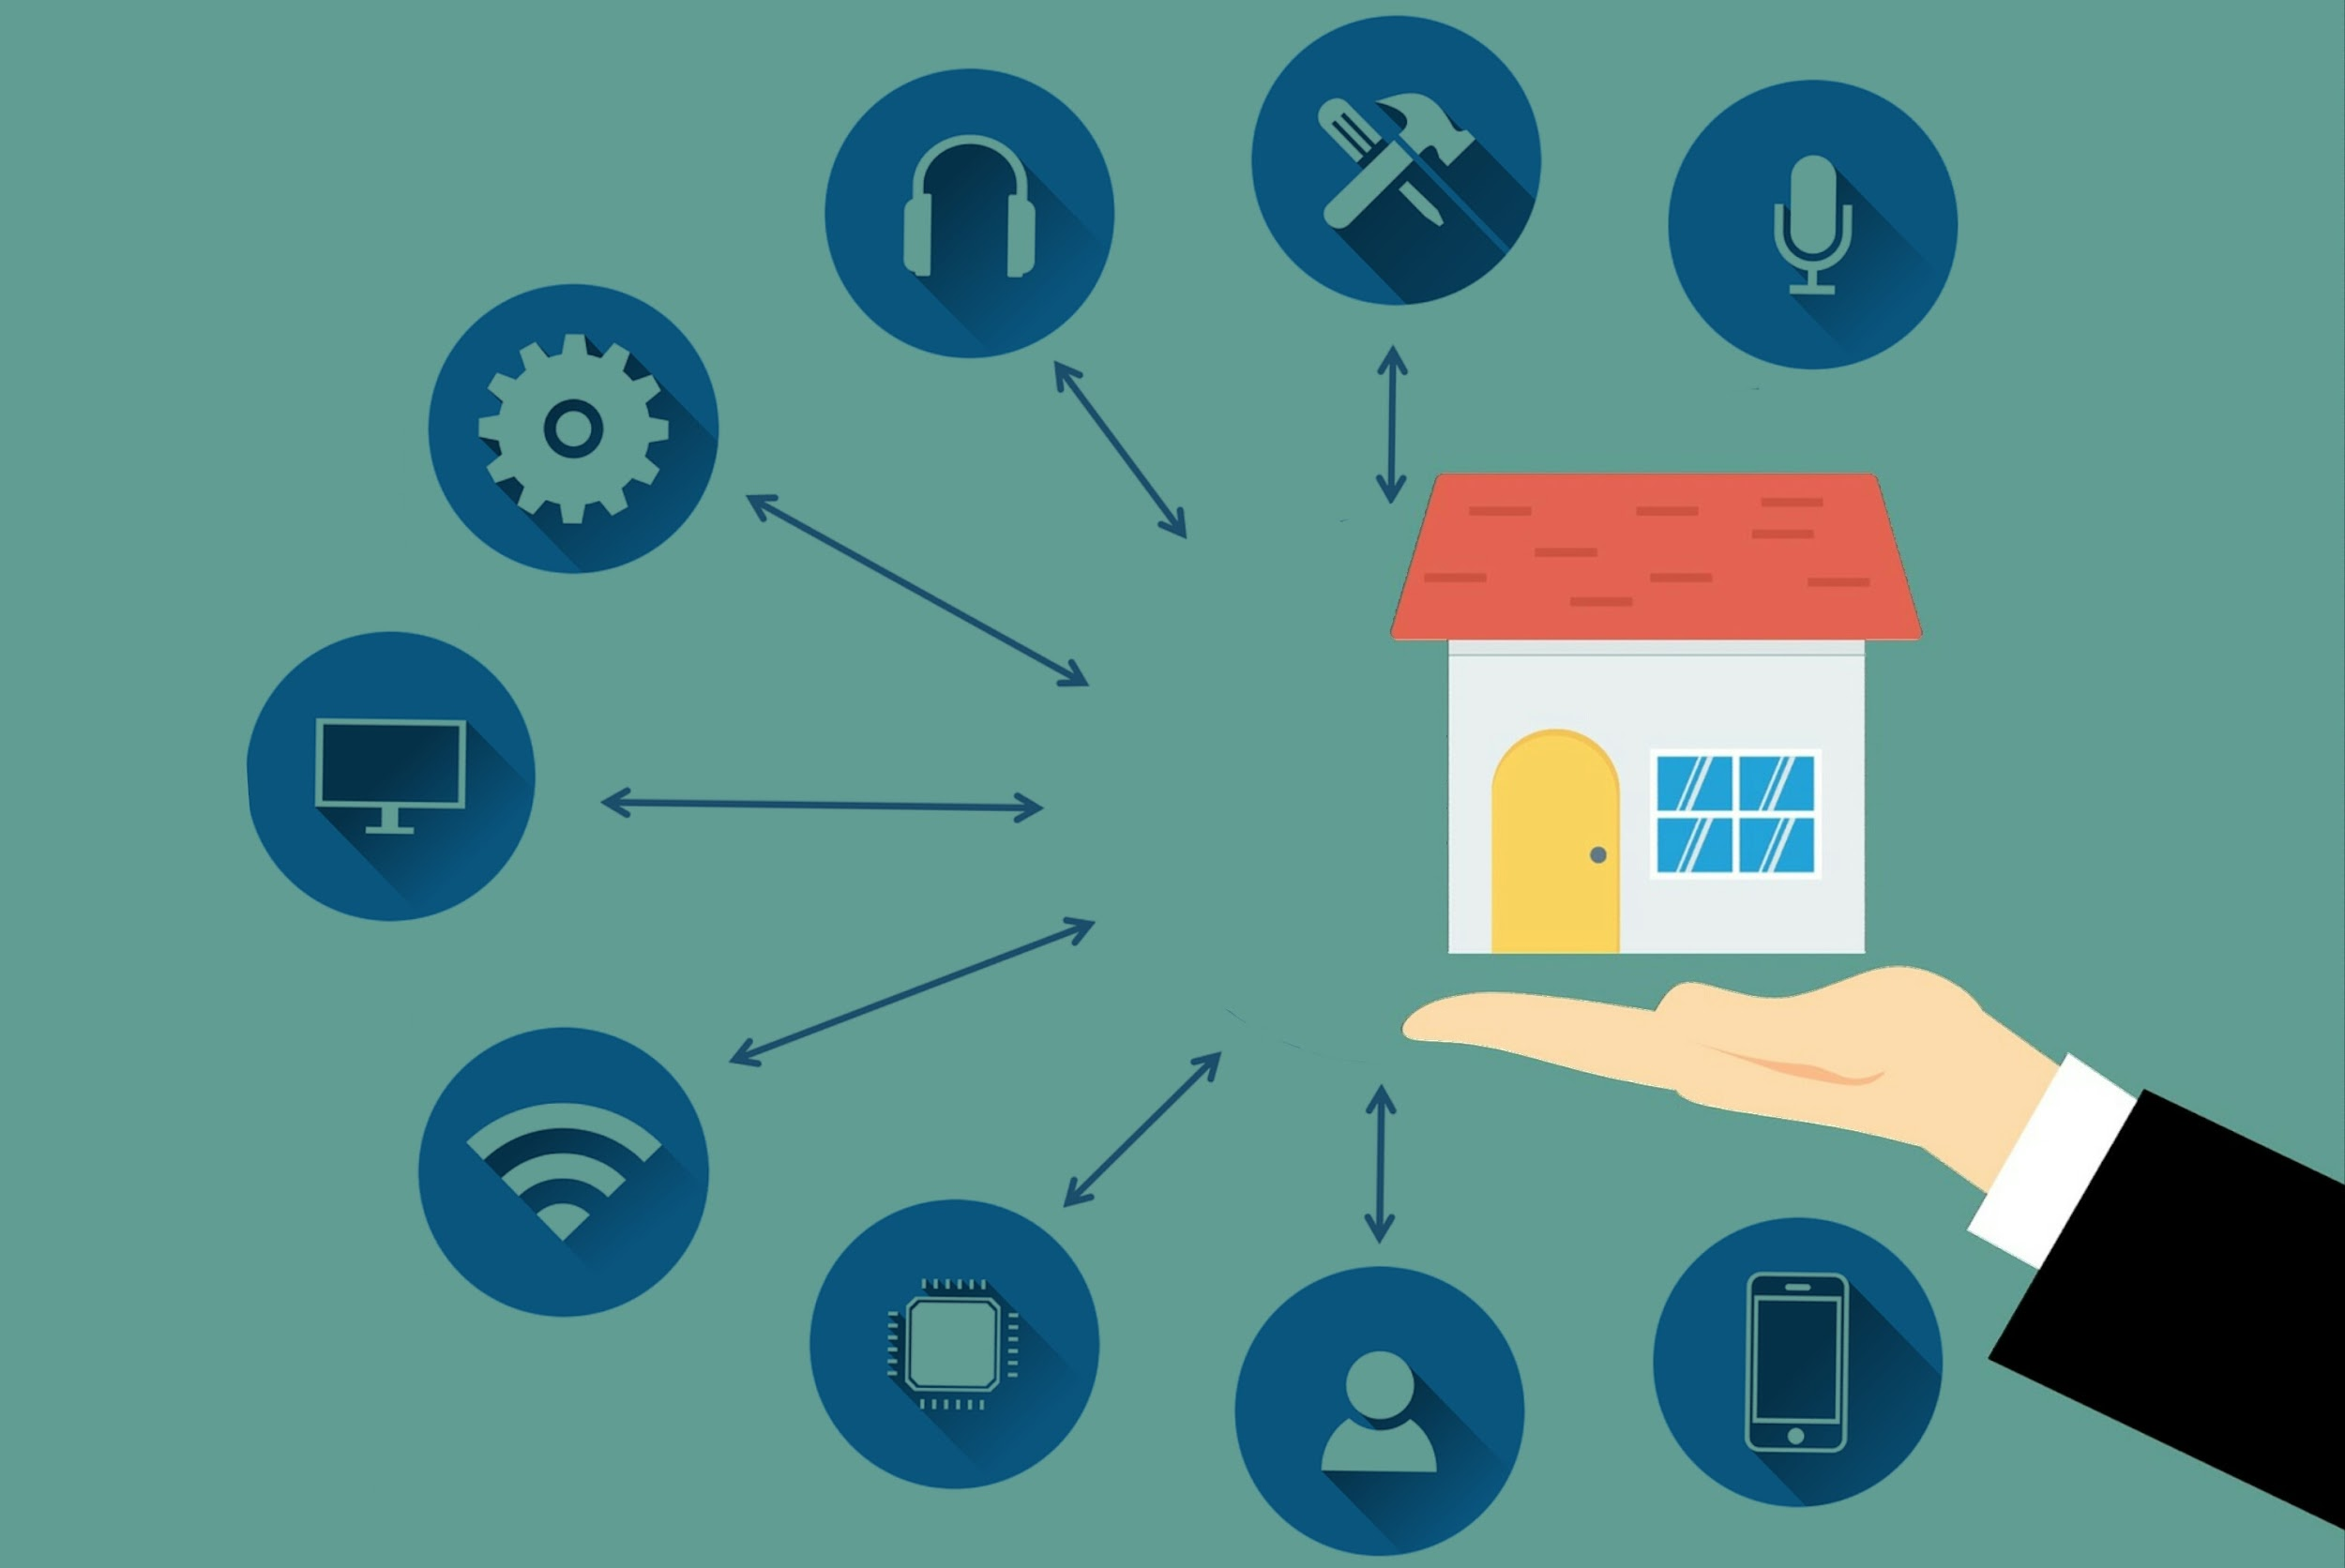
How does Home Automation works?
Home automation works via a network of devices that are connected to the Internet through different communication protocols, i.e Wi-Fi, Bluetooth and many others. Through electronic interfaces, the devices can be managed remotely through controllers, either a voice assistant like Alexa or Google Assistant or an app. Many of these IoT devices have sensors that monitor changes in motion, temperature, and light so the user can gain information about the device’s surroundings.
User -> Alexa (interprets the message) -> Sends message to your skill -> Skill Reacts (i.e., by dimming the lights etc...)

Slide 5
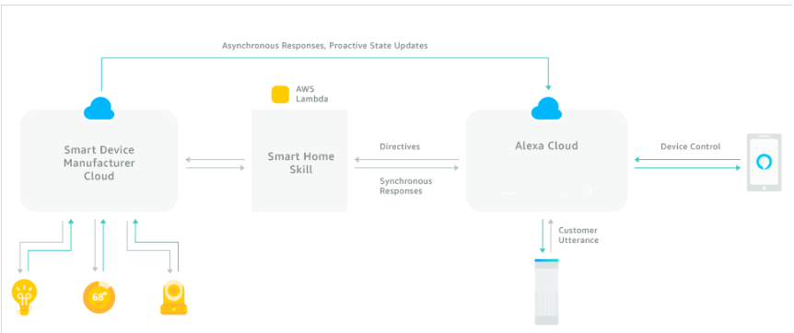
How does Home Automation works?(using amazon services)

Slide 6
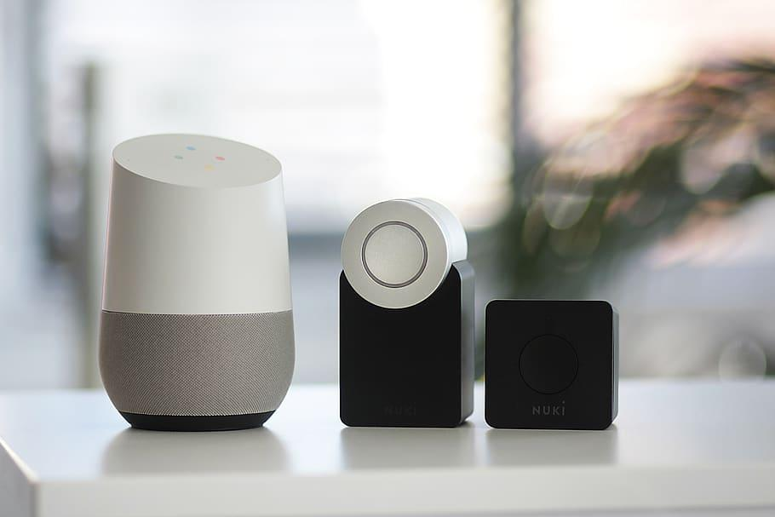
Home Automation System Components
• Alexa Echo (or a voice processing device.)
• IOT kit
• A relay to connect your IOT kit with your appliances.

Slide 7
Conclusion
Main purpose of home automation system is to provide ease to people to control different home appliances with the help of the different remote control like Mobile Application, Voice Assistants, Alexa, etc. and to save electricity, time and money. This system also helps the user to protect their homes from burglars when they are away from the home by using alarm as the alarm will start ringing whenever a burglar tries to enter the house and the person will receive a message on his mobile phone whenever some other person will try to enter the owner’s house.

Slide 8
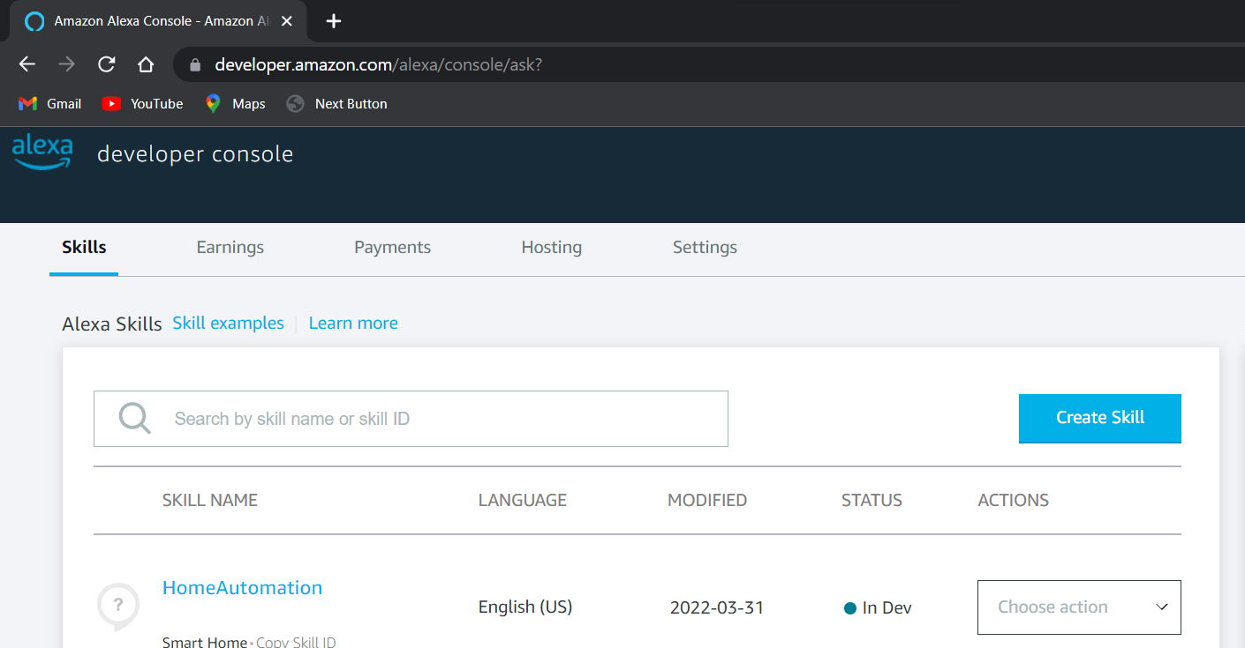
Steps to create a Skill
Firstly go to the amazon developer account and then go to skills and then click on create skill.

Slide 9
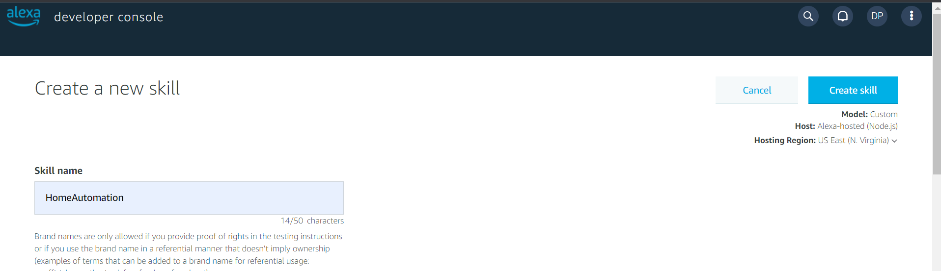
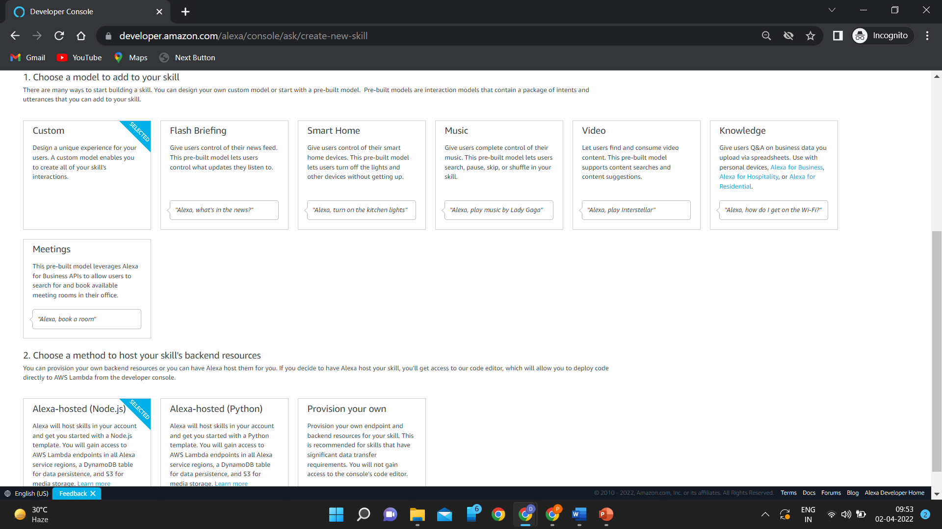
Give name to your skill.
In model choose the smart home.
And then select the Alexa – hosted Node.js method to host your skill’s backend resource

Slide 10
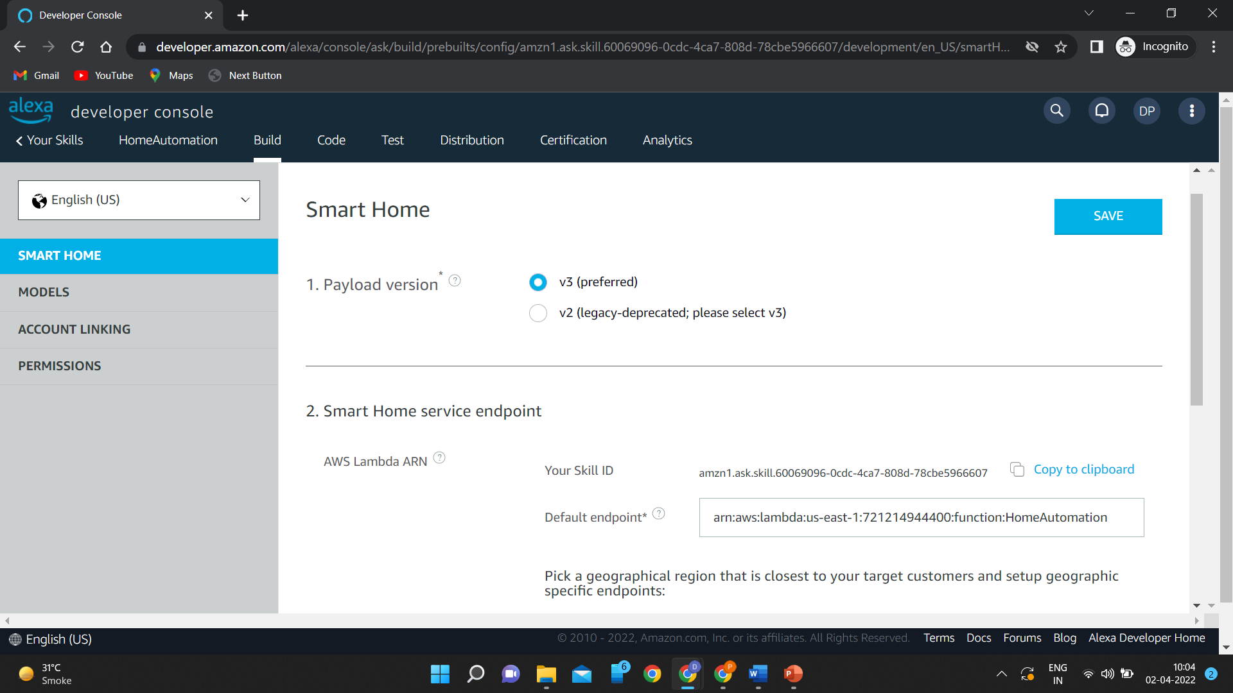
Select v3 in the payload version.
Copy your skill id and in the default endpoint copy the code of your lambda function created in your Aws account.

Slide 11
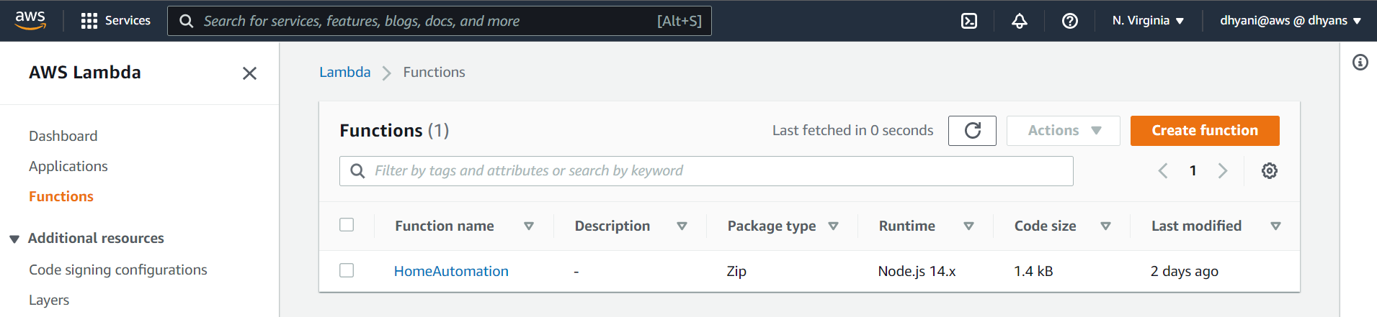
How to create Aws Lambda Function?
Go to your AWS account and in the search box find lambda. And then go to the Functions and click on Create Function.
Select the correct region for your function. For adding trigger select Alexa Smart Home. For Application ID paste your Skill ID.
And then implement the skill code.

Slide 12
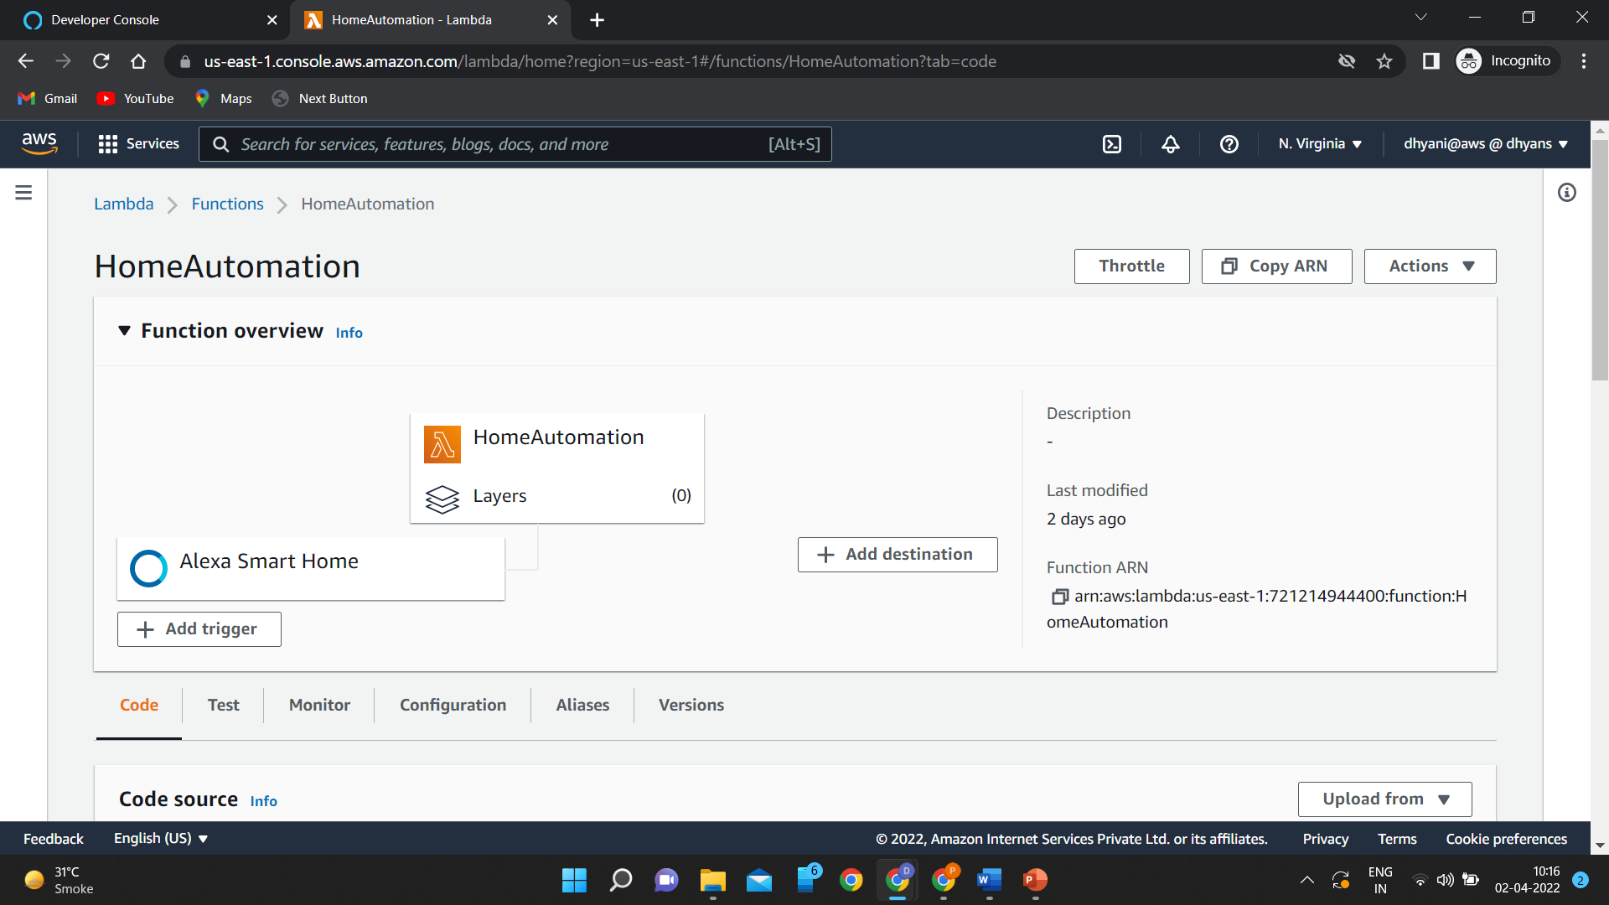
Copy the Function ARN to your skill.

Slide 13
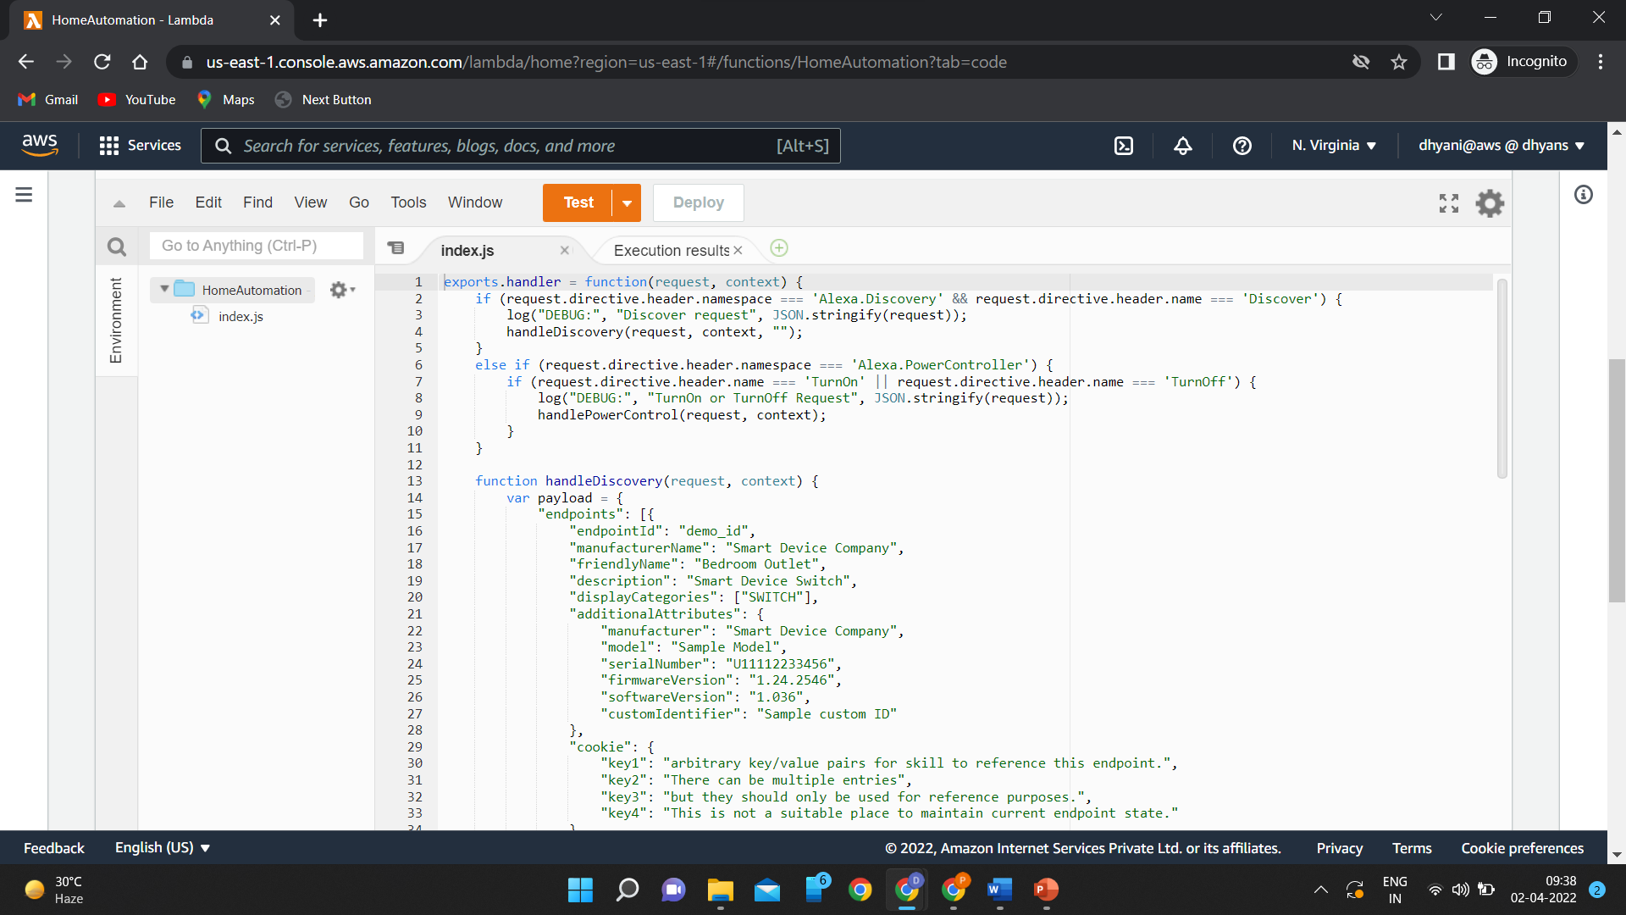
Aws Lambda Function

Slide 14
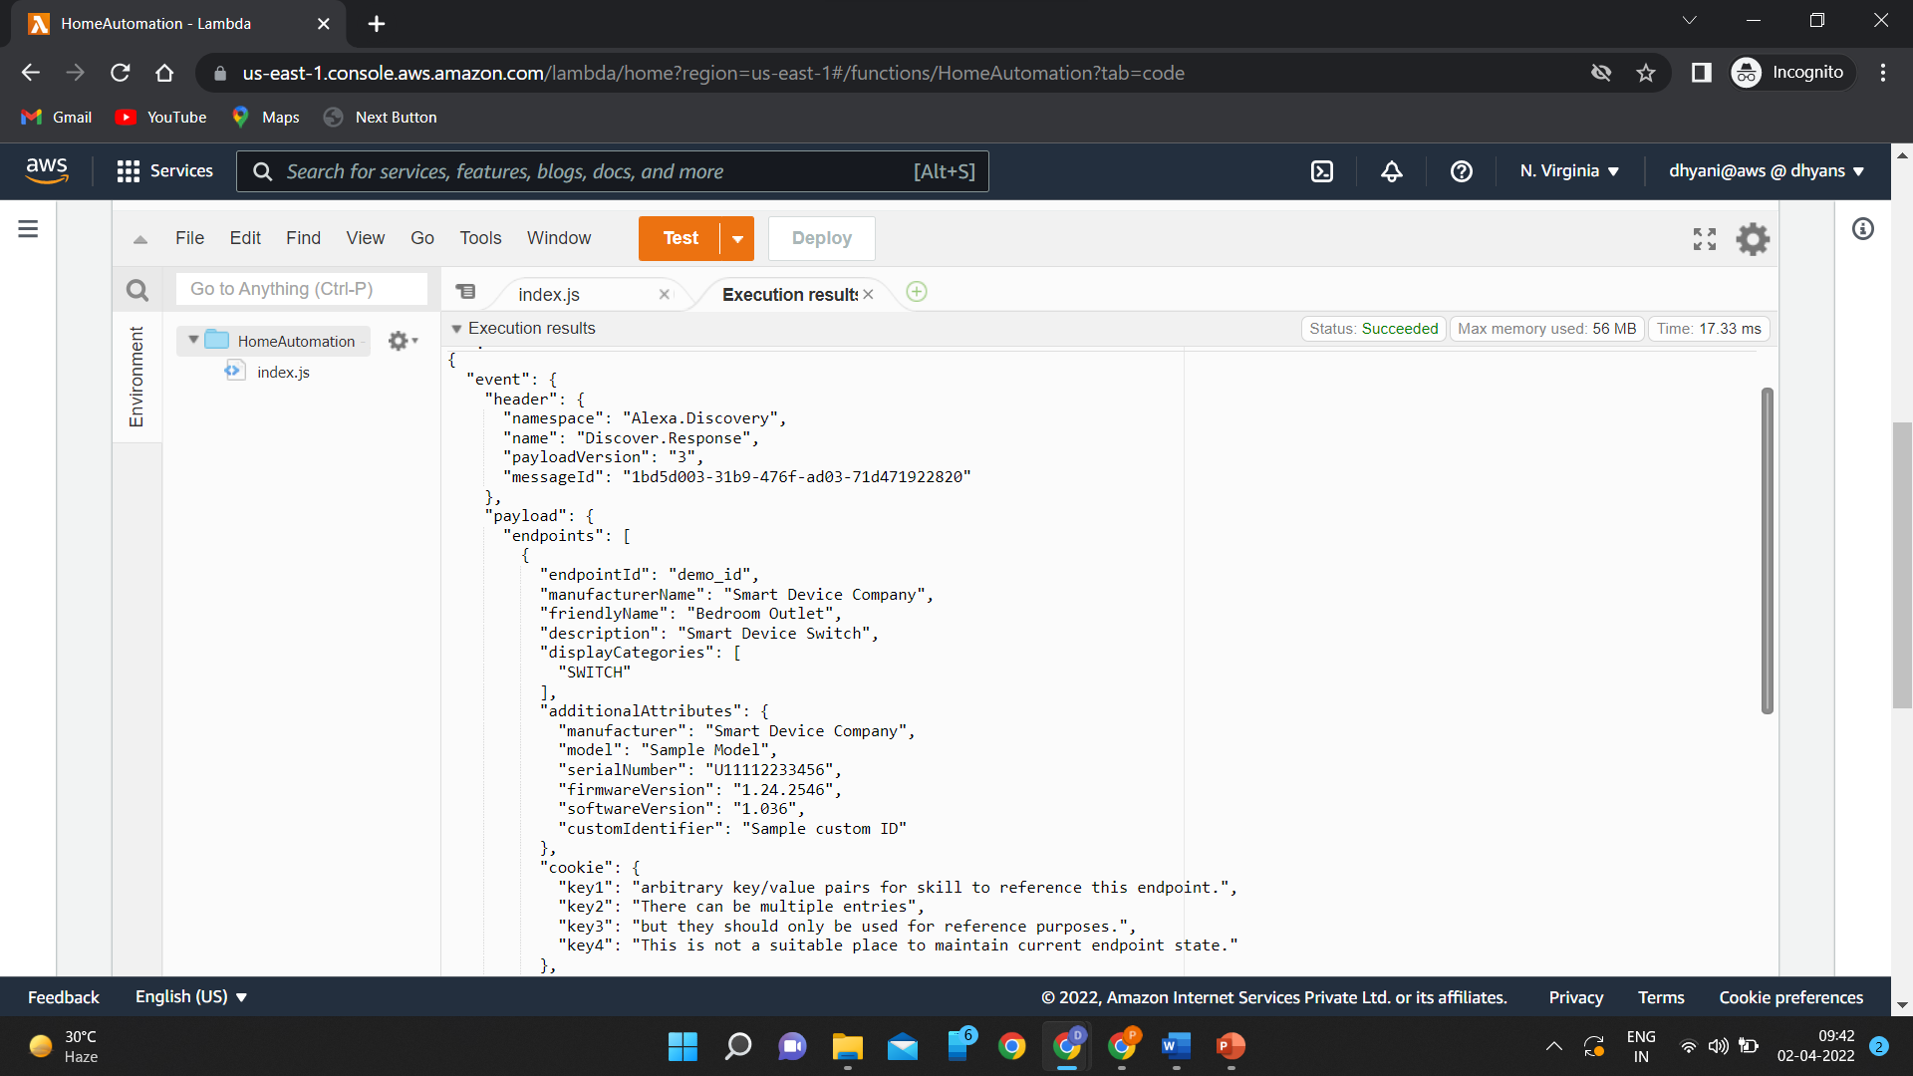
Output of the function

Slide 15
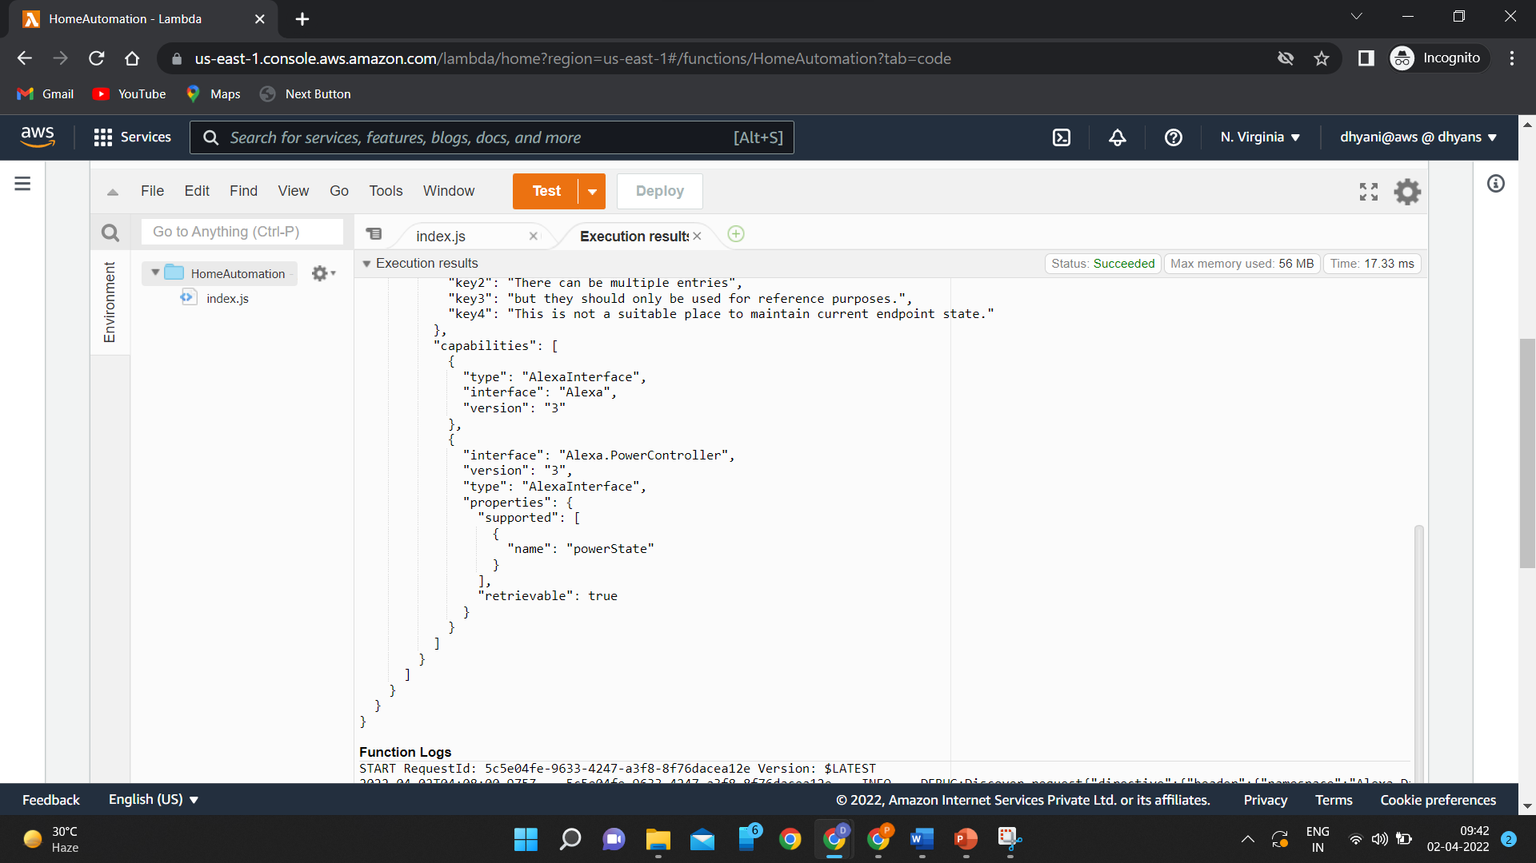

Slide 16
Thank You

